Slide 1
Database Lab 5
Team members:
Bachhas Nikita
Delon Lim Long Ting
Pang Kee Yang
Tan Hui Zhan
Notes:
Slides, Create Tables INSERT Tables,
Q1, Q2, Q3,
Q4, Q5, Q6
Interesting Queries, Triggers -

Slide 2
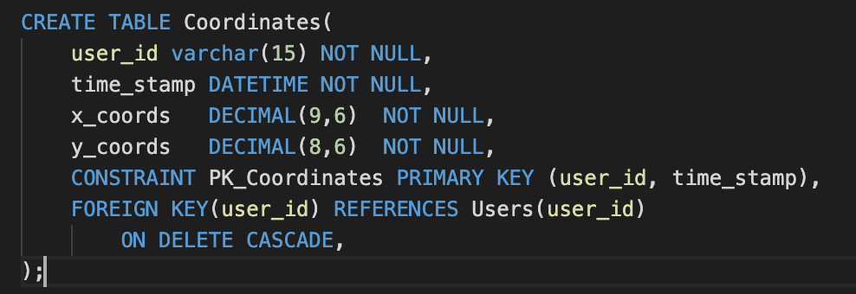
Create Tables
CREATE TABLE Table Name
Declare Attributes + Datatype
Declare NOT NULL: Attribute cannot be a null value
Primary Key
Foreign Key and Reference

Slide 3
On Update…On Delete
 | On Update Default On Delete Default | On Update Default On Delete Cascade | On Update No Action On Delete No Action | On Update Default On Delete No Action
Tables: | Users FamilyMembers | Coordinates Schedules TemperatureDeclarations ContactPersons CompanyLocations LocationCategories CheckInOuts Ratings Messages AdminMessages | CategoriesSubcategories | FamilyMembers Messages ContactPersonMessages Comments

Slide 4
On Update Default
On Delete Cascade

Slide 5
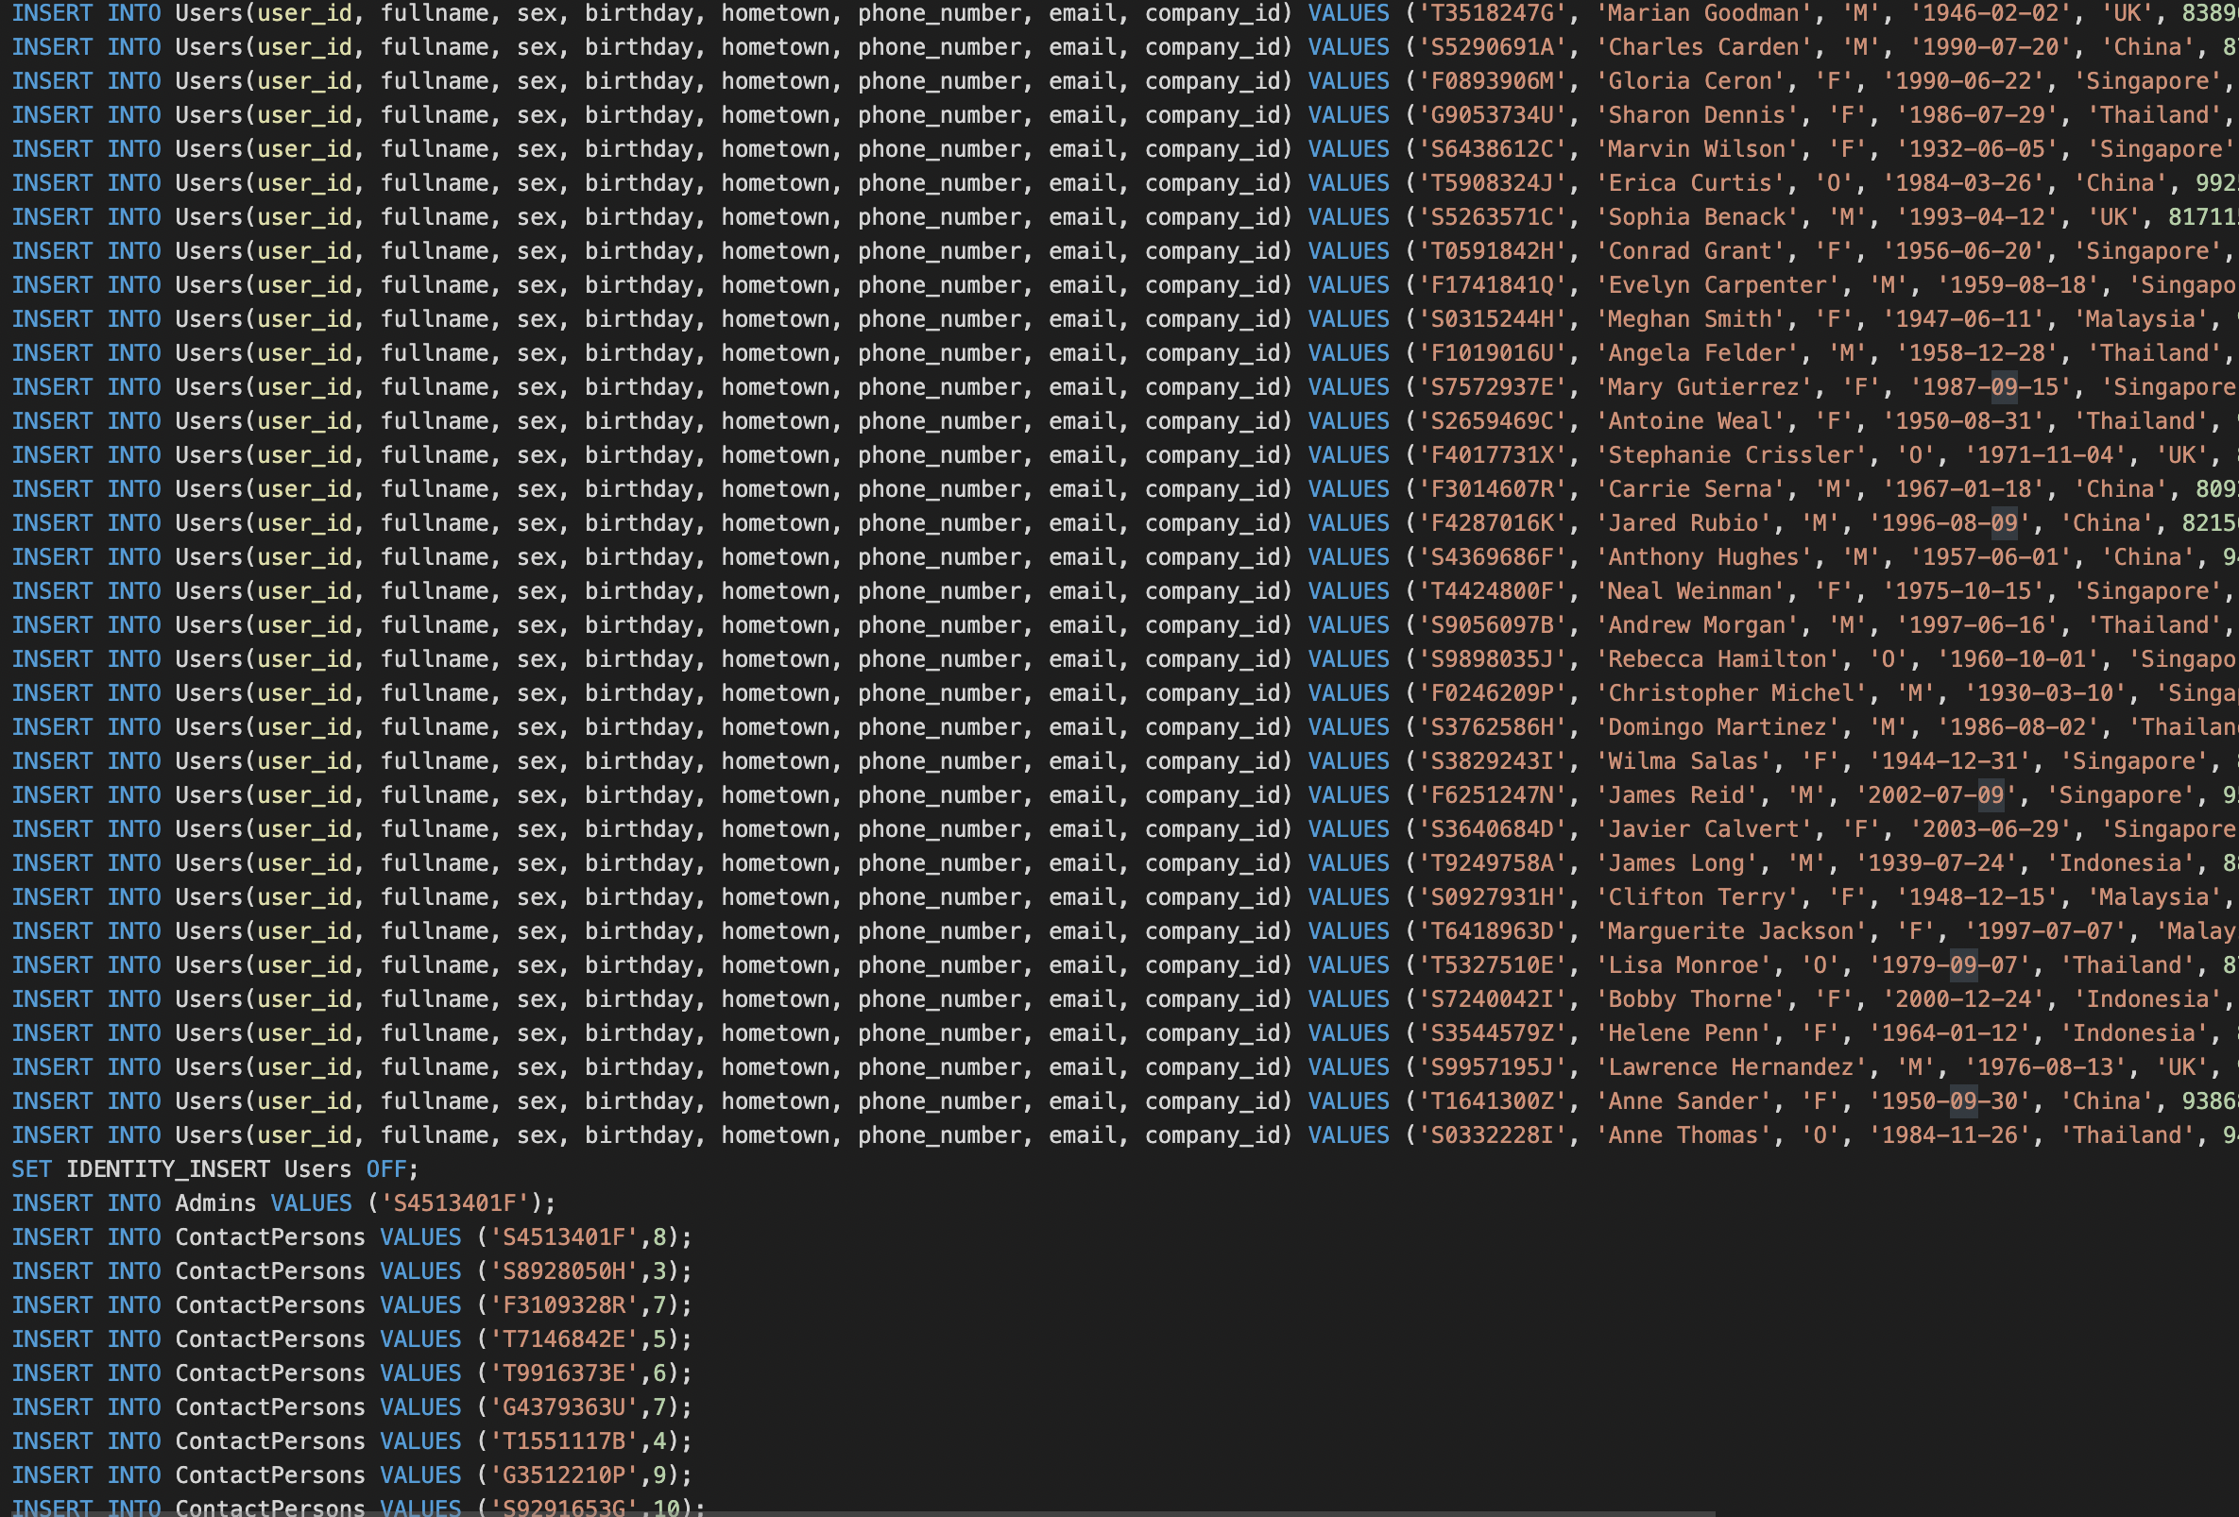


Inserting Dummy Data
Use of Google Collaboratory
Generation of Python Script
Snippet of what the Inserts looks like

Slide 6
Various table data type
Data Types | Examples
INT | Companies.company_id
VARCHAR(no.) | Relationships.relationship_str
Date | Users.birthday
DateTime | TemperatureDeclarations.time_stamp
DECIMAL | Coordinates. x_coords
Tinyint | Schedules.test_result
TIME | scheduled_time

Slide 7
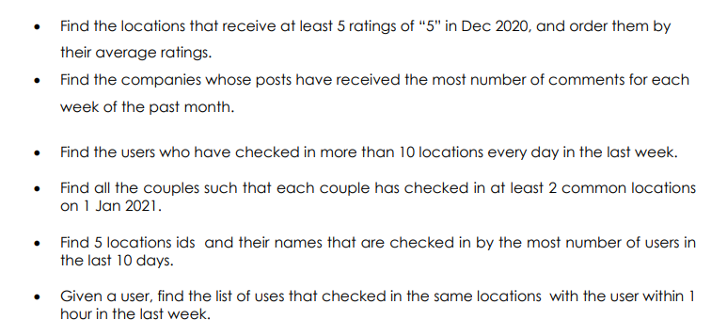
Queries 1-6

Slide 8
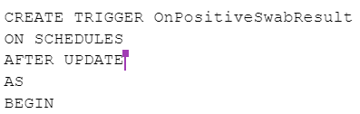
Interesting Query 1 (Include Trigger)
On update of positive swab test. (Trigger)
Find all the close contact of the userid
Insert all the new close contacts into the view table and display it out

Slide 9
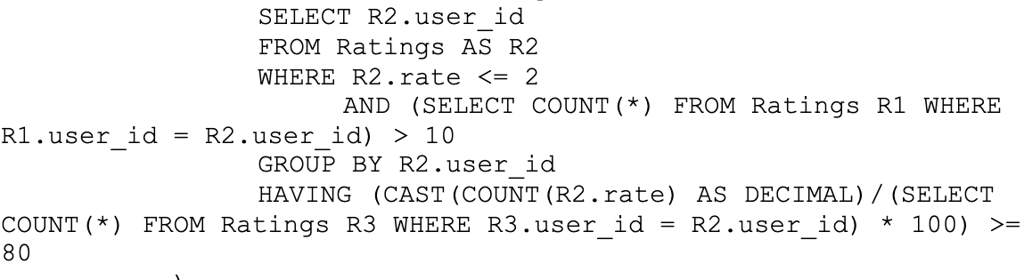
Interesting Query 2
Identify all locations with an average rating of 2.5
Identify all biased reviewers - i.e. reviewers who have more than 10 reviews and consistently leave bad ratings of 2 stars and below. 80% of their reviews are bad reviews
Find rating of locations after biased reviews are discounted. If their rating still remains <= 2.5, identify corresponding companies and their contact persons

Slide 10
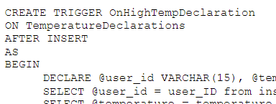
Another Interesting Trigger
Triggering event: If a new tuple in TemperatureDeclaration is > 37.5
Action: schedule a new swab test for him/her - insert new tuple in Schedule
}}}

Slide 11
Demonstration of Our Database

Slide 12
Thank you!
Q & A TIME

